Slide 1
UML Activity Diagrams

Slide 2
Overview
Purpose:
Describe a task/procedure/process
Components:
Activity - a non-atomic (i.e., decomposable) task
Action - an atomic (i.e., not decomposable) task
Data - inputs to or outputs from actions (and may include state information in square brackets)
Flow - flow of control and flow of data
Notes:
Unified modeling language
UML 1.X made for human only
UML 2.0 for Model Driven Architecture

Slide 3
An Example

Slide 4
Representation and Interpretation
Directed Graph:
Nodes/Vertexes - represent actions or objects
Edges/Arcs/Links - represent control flows and/or data flows
Tokens:
Produced and consumed by nodes (though not represented on the diagram)
Flow instantaneously along edges
Execution:
An action node begins executing when tokens are available on all incoming edges
When an action node begins execution it consumes all incoming tokens
While/after an action node executes it produces outgoing tokens

Slide 5
Symbology
Activities:
Actions:
Objects/Classes/Data:
Flows:

Slide 6
An Example

Slide 7
Additional Elements
Initial Node:
Final Node:
Decision Node:
One incoming edge
One or more outgoing edges
Outgoing edges can have a Boolean guard
Merge Node:
One or more incoming edges
One outgoing edge

Slide 8
An Example Revisited

Slide 9
Why Use Merge Nodes?
Compare the Following Two Activities:
An action does NOT start until the tokens on all of its incoming edges have arrived.
Decision/Merge nodes do NOT consume incoming token, but pass it along.
While actions consume incoming token and produce a new one after execution.

Slide 10
Still More Elements
Pin:
A terminator for data flows into (input pins) or out of (output pins) an action node
Activity Parameter:
An object node on the boundary of an activity
Contains the name of a particular object and the name of its type
Syntax: name:type

Slide 11
A Larger Example
Courtesy of Introduction to Software Engineering and Design (Fox, 2006)

Slide 12
The Larger Example with Object/Data Nodes

Slide 13
Sequential and Parallel Actions
Fork Node:
Splits a single (incoming) flow into multiple concurrent/parallel (outgoing) flows
Join Node:
Synchronizes multiple (incoming) flows into a single (outgoing) flow

Slide 14
An Example with Parallel Actions

Slide 15
Compare the Following Activity Diagrams

Slide 16
Abstraction and Sub-Activities
Abstraction in Activity Diagrams:
As with any model, a decision must be made about how much detail to include
Associating an Activity with an Action:
It's possible to indicate that a sub-activity exists for an action using the following notation:

Slide 17
In-class Activity

Slide 18
Exercise
1. Draw an activity diagram describing two people peeling a pot of potatoes. Note that two people do this in parallel and they stop when all the potatoes are peeled.
Hint: a pair of folk and join is needed

Slide 19
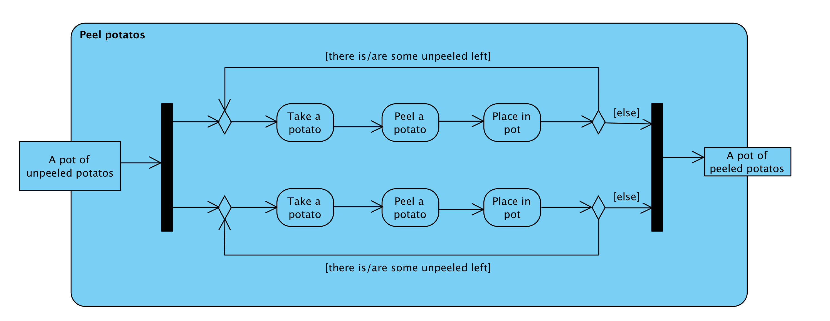
Draw an activity diagram describing two people peeling a pot of potatoes. Note that two people do this in parallel and they stop when all the potatoes are peeled.

Slide 20
Exercise
2. Draw an activity diagram describing an algorithm for finding the maximum value in a list. The input is the list, and output is the maximum value.
Hints:
Make your own assumptions
Design/choose the algorithm first, then model it with an activity diagram
Include appropriate level of detail in your model

